Slide 1
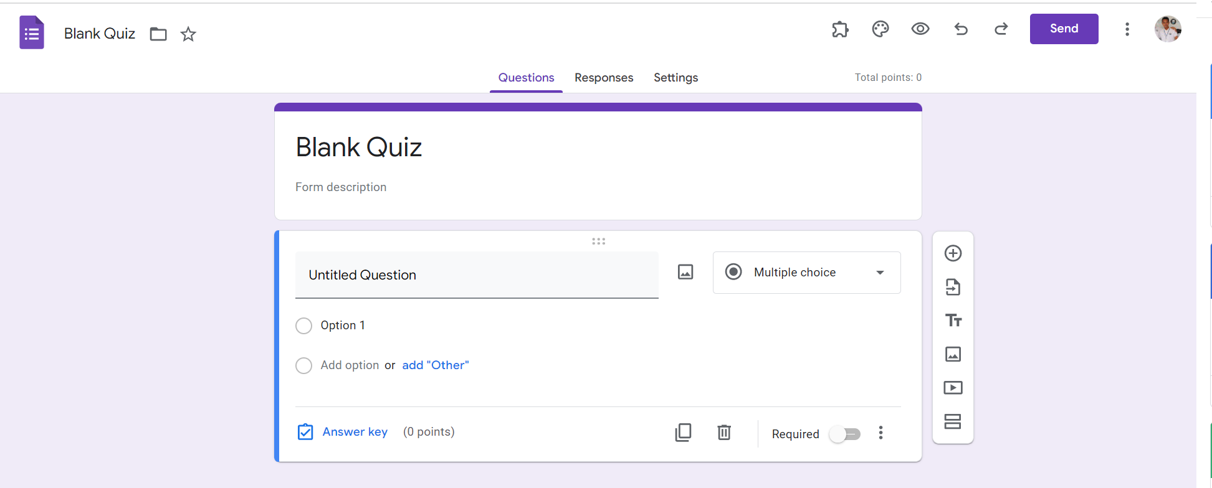
Identify root components of website below

Slide 2
Display:flex;
Flex-direction: column,
Navigation
Withd: 100vh
Flex :1
Withd: 60vh
Header
Flex 1.5
Flex: 2.5
Main
Withd: 70vh

Slide 3
Navigation
Nav-left
Nav-cener
Nav-right

Slide 4
Navigation
icon
title
icon
icon
icon
icon
icon
icon
title
icon
icon
title
title
title
title
Display : flex;
Flex-direction: row;
Justify-content: space-between
Display : flex;
Flex-direction: column;

Slide 5

header
title
title
Diplay:flex;
Flex-direction: column;

Slide 6
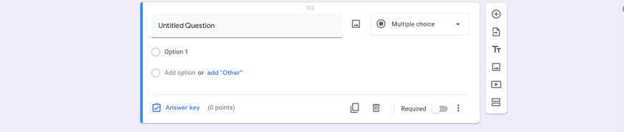
main
Diplay: flex;
Flex-direction: row;
Diplay: flex;
Flex-direction: column;

Slide 7
Text-align:center;
Diplay: flex;
Flex-direction: row;

Slide 8

Diplay: flex;
Flex-direction: column;
Diplay: flex;
Flex-direction: row;

Slide 9
icon
icon
title
icon
Icon
title
icon
title
icon
title
icon
icon
title
icon
icon
title
icon
icon
icon

